Slide 1
Remote Learning SMS-Grade 5
Monday, June 1, 2020

Slide 2
HAPPY JUNE!
Today is Monday, June 1st !
Please join me today for a Zoom at 10:00AM. Our Zoom today is going to be dedicated to presenting your final Spanish projects. Senora Lorenzo will be running the Zoom. If you do not participate in Spanish you do not have to come but you are welcome to.
The word list for our Spelling Bee is on Weebly, this list will be used for our Bee on Friday.
Finally, it was so great to see so many of you on Friday! Thank you for your thoughtful gifts. ☺

Slide 3
Daily Routine-At School (for reference)
Monday | Tuesday | Wednesday | Thursday | Friday
Morning math | Morning Math | Morning Math | Morning Math | Morning Math
Writers Workshop | Math | Math | Math | Math
Snack break | PE | Prayer/Service | Snack break | Snack break
Social Studies | Snack Break | Snack Break | Writers Workshop | Writers Workshop
Science | Social Studies | Social Studies | Social Studies | Social Studies
Spanish | Science | Science | Science | Science
Lunch/Recess | Lunch/Recess | Lunch/Recess | Lunch/Recess | Lunch/Recess
Math | Readers Workshop | Readers Workshop | Choir | Readers Workshop
Readers Workshop | Religion | Art | Readers Workshop | Spanish

Slide 4
Ideas for Possible Daily Routine At Home
After breakfast get settled at workspace and complete Morning Math on blank paper.
Work on subject assignments, if questions email me I will be checking my email on the hour.
Take a snack break/Facetime a friend ☺
If you can get outside for a quick break, do it.
Continue working on assignments, if you sent questions check email for answer from me.
Lunch-Buen Provecho (Enjoy your meal!)
Reading time, 20 minutes (at least) after lunch
If you can get back outside for a break, do it
Finish up any assignments, enjoy the rest of your day!

Slide 5
Morning Math
MUST DO
Please answer the daily questions from this morning math work on a blank paper with your name and title MW25
Question 1 each day is about calculating volume, we have not learned this together so question 1 each day is not required, if you would like to give it a try feel free.
The PDF is posted on Weebly. You do not have to print this. You can solve the problems by reading them on screen and solving them on paper.

Slide 6
Math
Today and tomorrow you will be working on a Number Scavenger Hunt at home. See below for details.

Slide 7
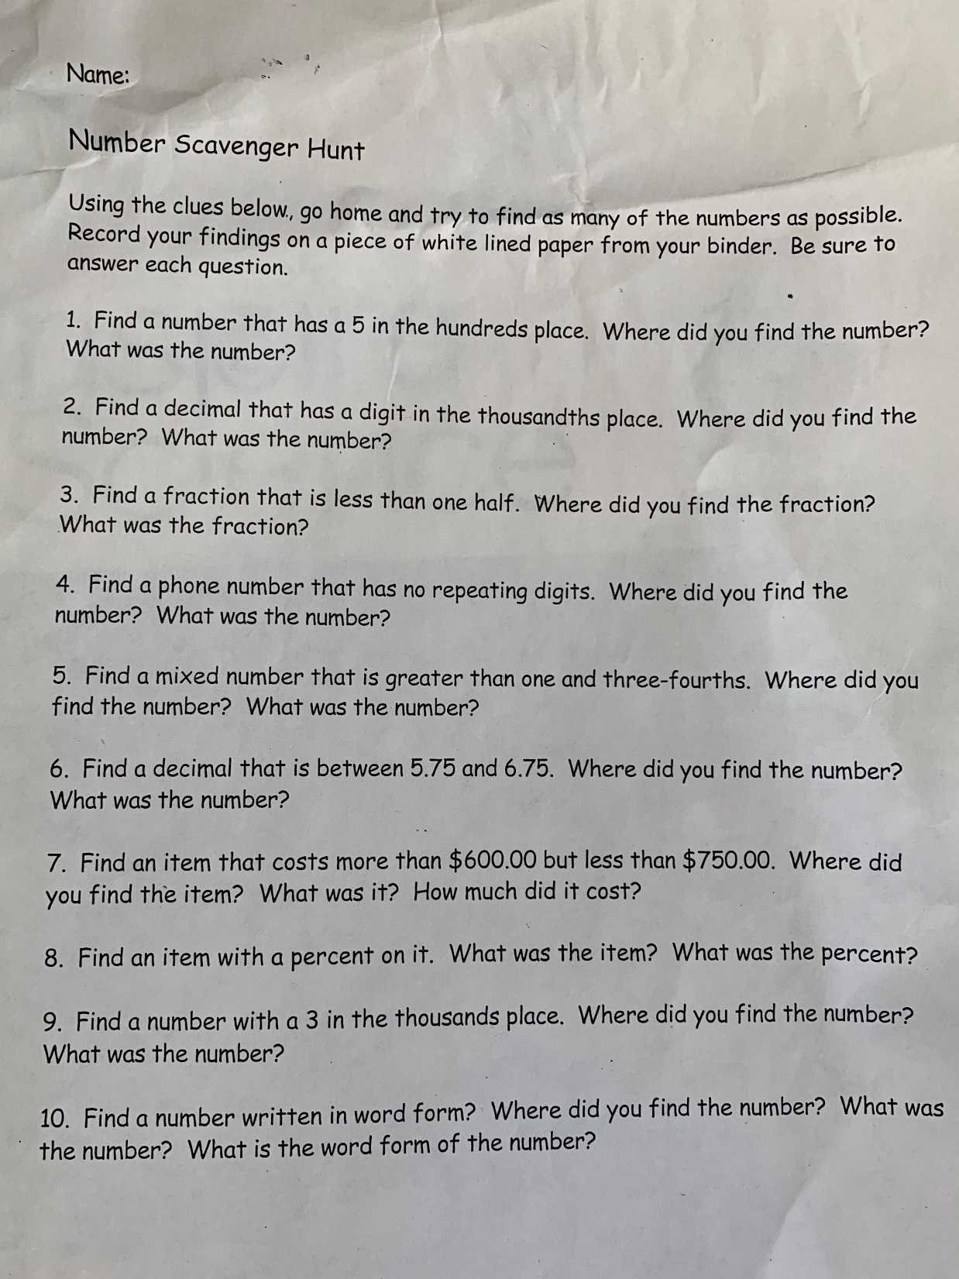

Slide 8
Social Studies
Great job on the Founding Fathers Webquest! Today you are going to complete an assignment on ReadWorks about how the nation began to move west.
https://www.readworks.org/article/Westward-Expansion---Introduction-to-Westward-Expansion/c25faa50-7324-4205-af6d-2774303b0701#!articleTab:content/
Our class code is A2S7RA

Slide 9
Science
Today you are going to view a video about the geosphere.
https://mass.pbslearningmedia.org/resource/idptv11.sci.ess.earthsys.d4kgeo/geology/
After watching the video complete a 3, 2, 1
3 new facts you learned
2 questions you have
1 WOW fact

Slide 10
Readers Workshop
Please continue to read at least 20 minutes daily. Keep a log of what you are reading, for example:
Date Title of Book Minutes Spent Reading
I’m keeping the Epic instructions up for anyone who may want them.
https://www.getepic.com/learn/freeremotestudentaccess/
Our class code is: ipq0478

Slide 11
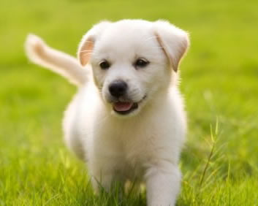
Enjoy the Day!

