Slide 1
Remote Learning SMS-Grade 5
Tuesday, June 2, 2020

Slide 2
GOOD MORNING!
Good morning, today is Tuesday, June 2nd.
Be sure to read the slides thoroughly. There is a Virtual Field Day Challenge today.
Please join our Zoom today at 10:00AM. Be sure to have with you:
Paper and pencil or a whiteboard and marker if you have it
We are nearing the end of our Grade 5 journey together, 9 days left-SINGLE DIGITS! Please hang in there and finish strong. You can do it!

Slide 3
Daily Routine-At School (for reference)
Monday | Tuesday | Wednesday | Thursday | Friday
Morning math | Morning Math | Morning Math | Morning Math | Morning Math
Writers Workshop | Math | Math | Math | Math
Snack break | PE | Prayer/Service | Snack break | Snack break
Social Studies | Snack Break | Snack Break | Writers Workshop | Writers Workshop
Science | Social Studies | Social Studies | Social Studies | Social Studies
Spanish | Science | Science | Science | Science
Lunch/Recess | Lunch/Recess | Lunch/Recess | Lunch/Recess | Lunch/Recess
Math | Readers Workshop | Readers Workshop | Choir | Readers Workshop
Readers Workshop | Religion | Art | Readers Workshop | Spanish

Slide 4
Ideas for Possible Daily Routine At Home
After breakfast get settled at workspace and complete Morning Math on blank paper.
Work on subject assignments, if questions email me I will be checking my email on the hour.
Take a snack break/Facetime a friend ☺
If you can get outside for a quick break, do it.
Continue working on assignments, if you sent questions check email for answer from me.
Lunch-Buen Provecho (Enjoy your meal!)
Reading time, 20 minutes (at least) after lunch
If you can get back outside for a break, do it
Finish up any assignments, enjoy the rest of your day!

Slide 5
Morning Math
MUST DO
Please answer the daily questions from this morning math work on a blank paper with your name and title MW25
Question 1 each day is about calculating volume, we have not learned this together so question 1 each day is not required, if you would like to give it a try feel free.
The PDF is posted on Weebly. You do not have to print this. You can solve the problems by reading them on screen and solving them on paper.

Slide 6
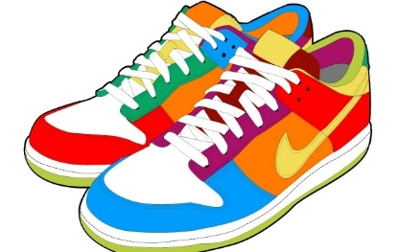
Virtual Field Day
Today’s field day activity is the Towel Flip Challenge, watch the video for instructions. Send me a video or pic of you completing the challenge OR the time it took you to complete it ☺. Good Luck!
https://www.youtube.com/watch?v=AmXOOqEEl9A

Slide 7
Math
Today you will be finishing your Number Scavenger Hunt at home. See below for details.

Slide 8
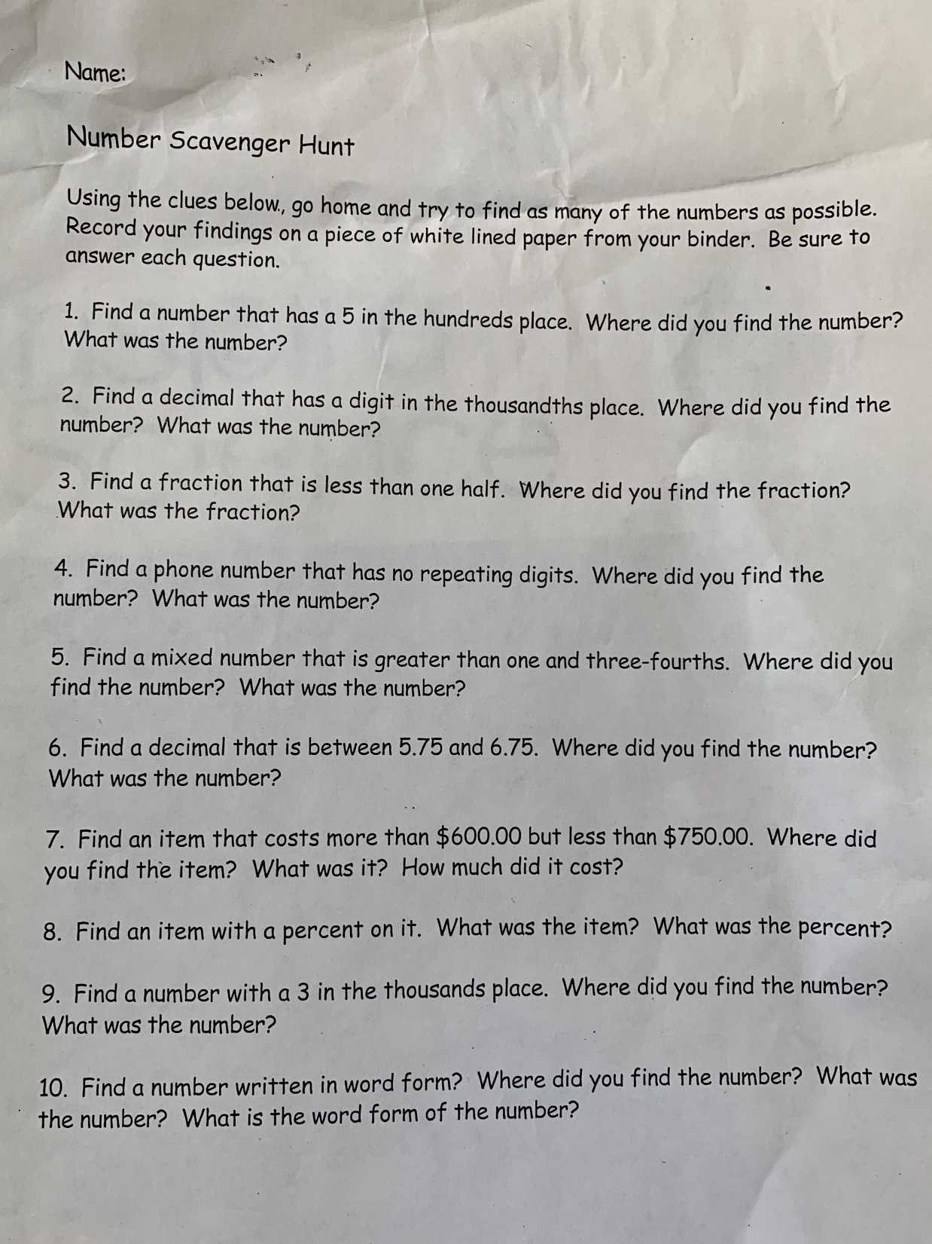

Slide 9
Social Studies
We will continue our look at westward expansion. Today you are going to complete an assignment on ReadWorks about the expedition of Lewis and Clark.
https://www.readworks.org/article/Mapping-the-West-The-Journey-of-Lewis-and-Clark/b9051902-07ff-426a-adcf-80643f01862b#!articleTab:content/
Our class code is A2S7RA

Slide 10
Science
Today you are going to view a video about the rocks.
https://mass.pbslearningmedia.org/resource/idptv11.sci.ess.earthsys.d4krom/rocks-and-minerals/
After watching the video answer the following questions:
How are rocks classified?
What forces can change rocks?
Most of the earth is made of what kind of rock? Why?

Slide 11
Readers Workshop
What was your favorite thing that we read together this year? Tell me the title and why you liked it? Feel free to draw me a picture to go along with your opinion.
In addition to your Book Club Project please read at least 20 minutes daily. Keep a log of what you are reading, for example:
Date Title of Book Minutes Spent Reading
I’m keeping the Epic instructions up for anyone who may want them.
https://www.getepic.com/learn/freeremotestudentaccess/
Our class code is: ipq0478

Slide 12
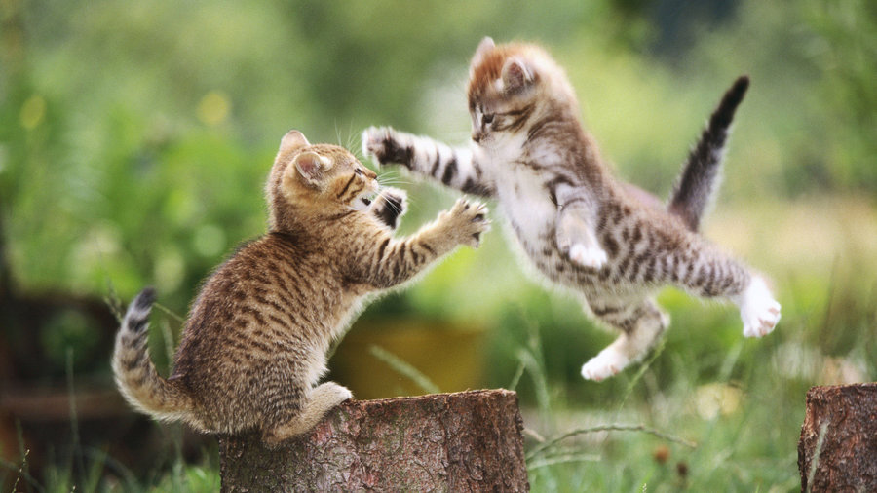
We Made it!
Be well, enjoy the rest of your day!

