Slide 1
Remote Learning SMS-Grade 5
Wednesday May 27, 2020

Slide 2
GOOD MORNING!
Good morning, today is Wednesday, May 27th.
Be sure to read the slides thoroughly.
Please join us at 10AM for our class Zoom. Mr. Bagley will be joining us to speak about his experience as a meteorologist and answer questions. Please be on time to the Zoom.

Slide 3
Daily Routine-At School (for reference)
Monday | Tuesday | Wednesday | Thursday | Friday
Morning math | Morning Math | Morning Math | Morning Math | Morning Math
Writers Workshop | Math | Math | Math | Math
Snack break | PE | Prayer/Service | Snack break | Snack break
Social Studies | Snack Break | Snack Break | Writers Workshop | Writers Workshop
Science | Social Studies | Social Studies | Social Studies | Social Studies
Spanish | Science | Science | Science | Science
Lunch/Recess | Lunch/Recess | Lunch/Recess | Lunch/Recess | Lunch/Recess
Math | Readers Workshop | Readers Workshop | Choir | Readers Workshop
Readers Workshop | Religion | Art | Readers Workshop | Spanish

Slide 4
Ideas for Possible Daily Routine At Home
After breakfast get settled at workspace and complete Morning Math on blank paper.
Work on subject assignments, if questions email me I will be checking my email on the hour.
Take a snack break/Facetime a friend ☺
If you can get outside for a quick break, do it.
Continue working on assignments, if you sent questions check email for answer from me.
Lunch-Buen Provecho (Enjoy your meal!)
Reading time, 20 minutes (at least) after lunch
If you can get back outside for a break, do it
Finish up any assignments, enjoy the rest of your day!

Slide 5
Morning Math
MUST DO
Please answer the daily questions from this morning math work on a blank paper with your name and title MW24.
The PDF is posted on Weebly. You do not have to print this. You can solve the problems by reading them on screen and solving them on paper.

Slide 6
Math
Dividing Fractions Check-In-TAKE TWO ☺
Please complete the must do check-in below, the second slide is a can-do it is NOT required

Slide 7
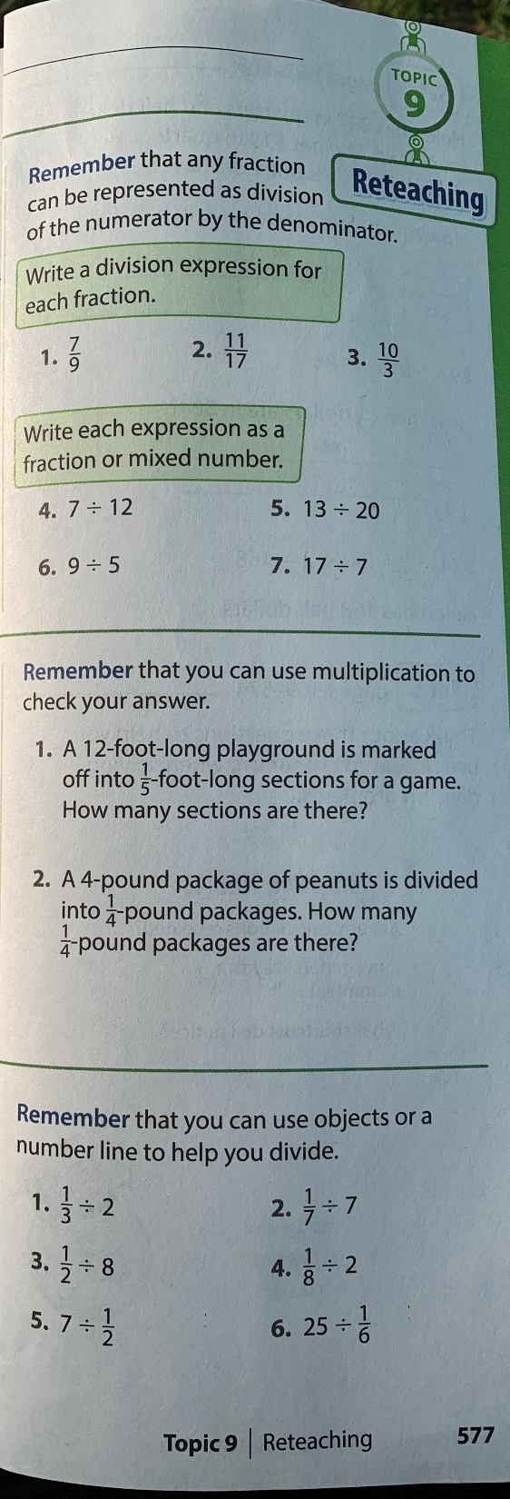

Slide 8
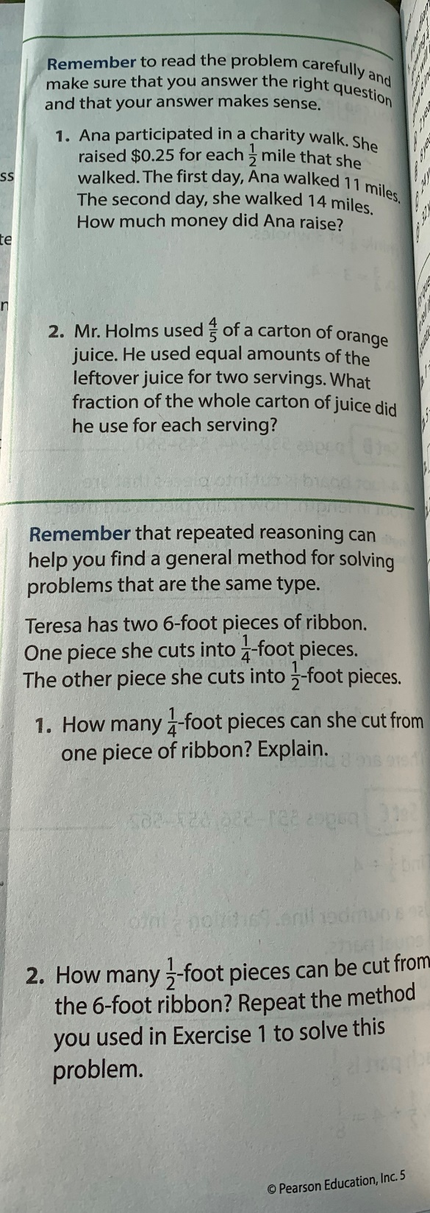

Slide 9
Weekly Mass
As we will not be attending weekly Mass, please take some quiet time today to reflect and pray.
Reflect on this time away from school. What is it like being home? How can you make the most of this time? How can you spend your time and energy in a way that is purposeful? How can you use this time to enjoy your family and show them how thankful you are for them?
Pray for those in need. Pray for those worries you have in your mind and heart. Pray for any special intentions. God is listening, He is always there.
There is no wrong way to pray, you can pray alone or with family, aloud or quietly in your mind. God is listening.
Please share how you observe our weekly Mass time at home. Submit it as a text to your Class Dojo Portfolio.

Slide 10
Social Studies
This week you will be working on and completing a WebQuest, the assignment is posted on weebly.
A WebQuest is an internet scavenger hunt. The WebQuest you will be completing this week is about the Founding Fathers of the U.S.A.
There are 54 questions to be answered. As this is a short week I recommend answering 13 or 14 questions each day. The last 4 are to be longer in response as they are deeper thinking questions. Please be sure to answer all questions (in complete sentences) on paper, in a document or text and submit through Dojo on or before Friday, May 29th. Happy hunting!

Slide 11
Science
Please continue reading about Earth’s atmosphere, specifically weather. After reading pgs 194-195 please draw a scene that includes your precipitation of choice. For example a park on a rainy day or a hail storm in someone’s yard.
Please be detailed with the precipitation as it is described in the text. Have fun with it and put forth your best effort.
Post a picture of your drawing to your Dojo portfolio or email it to me. I will be posting them on our website.

Slide 12
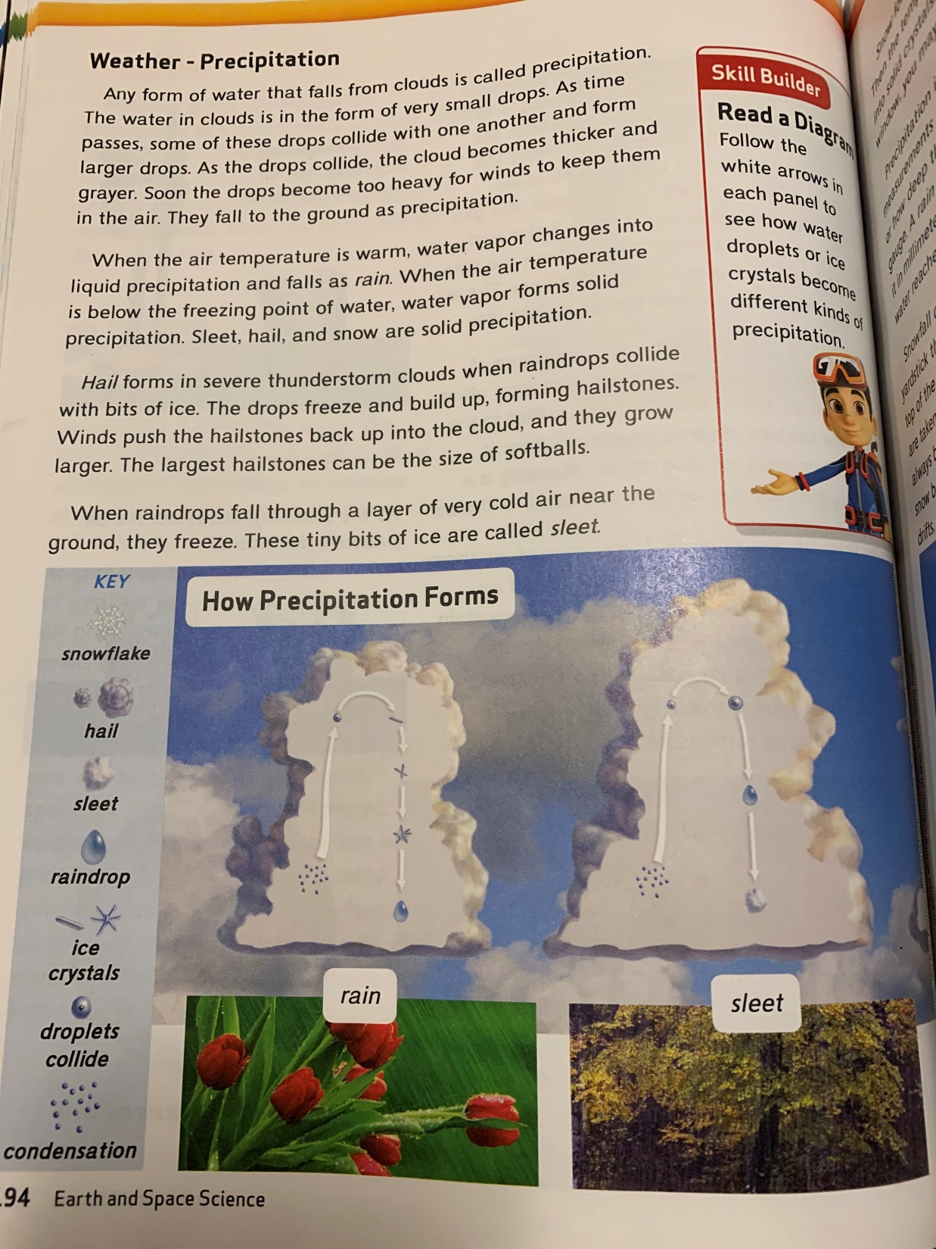

Slide 13
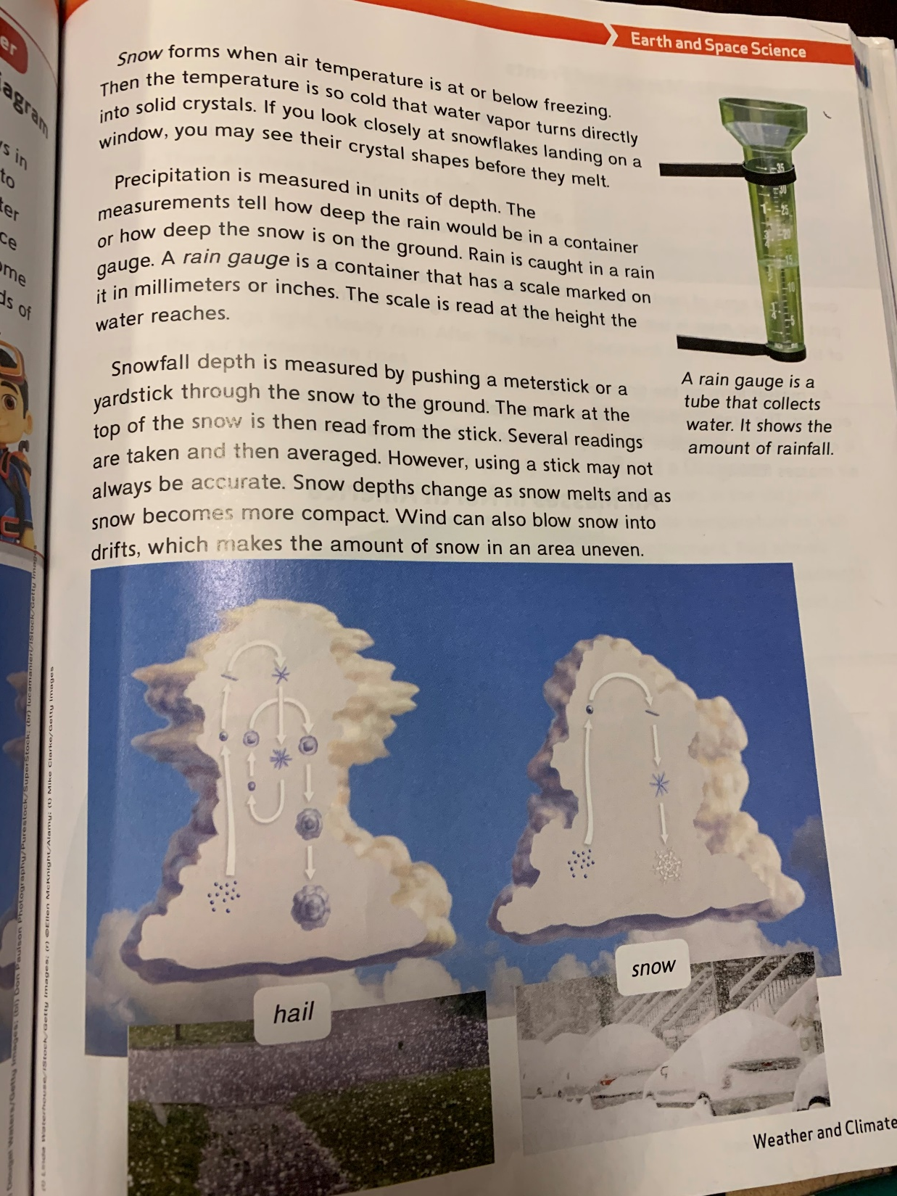

Slide 14
Readers Workshop
In addition to your Book Club Project please read at least 20 minutes daily. Keep a log of what you are reading, for example:
Date Title of Book Minutes Spent Reading
I’m keeping the Epic instructions up for anyone who may want them.
https://www.getepic.com/learn/freeremotestudentaccess/
Our class code is: ipq0478

Slide 15
Art
I showed you Finn’s positive and negative art from last week. I thought it was pretty neat. Give it a try if you’d like:
https://www.youtube.com/watch?v=1Ts0RN5_E1A
You will need paper, a black marker or pencil and a straight edge.

Slide 16
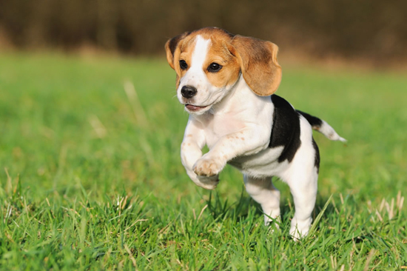
We Made it!
Be well, enjoy the rest of your day!

